Slide 1
Scatter Graphs
SUCCESS CRITERIA: Where are you now?
Tick what you currently know about scatter graphs in the table below (one tick in each row please):
Level | Learning outcomes | R | A | G
C3 | Can I plot points on a scatter graph?
C2 | Can I describe the relationship between the data, including correlation?
C1 | Can I draw and use a "line of best fit" to estimate results?

Slide 2
What are scatter graphs?
Scatter graphs show the relationship between two sets of data. Points are plotted very like co-ordinates.
Below are the marks of eight students in their Maths and Science tests.
Student | A | B | C | D | E | F | G | H
Maths mark | 56 | 73 | 51 | 62 | 24 | 67 | 94 | 35
Science mark | 62 | 68 | 45 | 68 | 35 | 73 | 88 | 32

Slide 3
Draw a scatter graph of this information:
Student | A | B | C | D | E | F | G | H
Maths mark | 56 | 73 | 51 | 62 | 24 | 67 | 94 | 35
Science mark | 62 | 68 | 45 | 68 | 35 | 73 | 88 | 32
100
90
80
70
60
Science mark
50
40
30
20
10
0
10
20
30
40
50
60
70
80
90
100
Maths mark

Slide 4
Draw a scatter graph of this information:
Student | A | B | C | D | E | F | G | H
Maths mark | 56 | 73 | 51 | 62 | 24 | 67 | 94 | 35
Science mark | 62 | 68 | 45 | 68 | 35 | 73 | 88 | 32
What yours should look like:
100
90
80
70
60
Science mark
50
40
30
20
10
0
10
20
30
40
50
60
70
80
90
100
Maths mark

Slide 5
Plot these sets of data on scatter graphs:
The data below shows the number of scarves sold by a shop in a week and the temperature that day:
Day of the week | M | T | W | T | F | S | S
Sales of scarves | 73 | 56 | 54 | 38 | 7 | 39 | 82
Temperature (oC) | 9 | 13 | 15 | 19 | 25 | 12 | 5
The data below shows the amount of petrol used by a car and the distance driven on eight different journeys:
Journey | 1 | 2 | 3 | 4 | 5 | 6 | 7 | 8
Distance (km) | 75 | 140 | 237 | 180 | 20 | 93 | 104 | 42
Petrol used (l) | 7 | 12.5 | 25.3 | 16 | 3.5 | 8.9 | 9.5 | 4.1

Slide 6
How your scatter graph should look:
Day of the week | M | T | W | T | F | S | S
Sales of scarves | 73 | 56 | 54 | 38 | 7 | 39 | 82
Temperature (oC) | 9 | 13 | 15 | 19 | 20 | 12 | 5
20
15
Temperature (ºC)
10
5
0
10
20
30
40
50
60
70
80
90
100
Sales of scarves

Slide 7
How your scatter graph should look:
Journey | 1 | 2 | 3 | 4 | 5 | 6 | 7 | 8
Distance (km) | 75 | 140 | 197 | 180 | 20 | 93 | 104 | 42
Petrol used (l) | 7 | 12.5 | 21.3 | 16 | 3.5 | 8.9 | 9.5 | 4.1
25
20
15
Petrol used (l)
10
5
0
20
40
60
80
100
120
140
160
180
200
Distance (km)

Slide 8
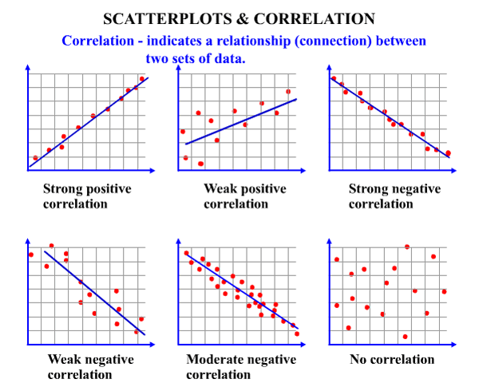
What do scatter graphs tell us?
Scatter graphs show the relationship between our two sets of data.
We describe this relationship using correlation.
There are basically 3 types of correlation:
Positive, Negative and No Correlation
The more in line the points, the stronger the correlation.

Slide 9
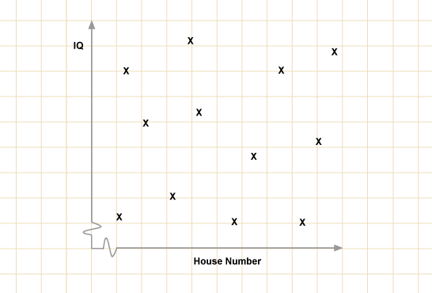
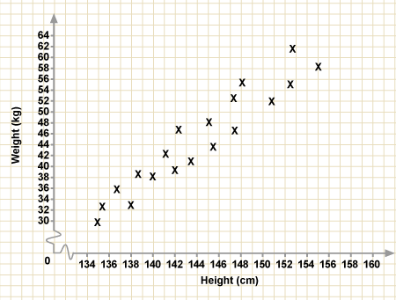
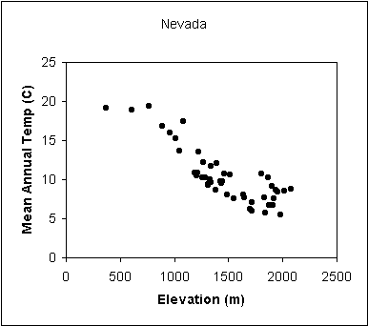
Describe the correlation of these scatter graphs:

Slide 10
Draw a scatter graph of this information and describe the correlation:
Student | A | B | C | D | E | F | G | H
Maths mark | 56 | 73 | 51 | 62 | 24 | 67 | 94 | 35
Art mark | 54 | 43 | 47 | 44 | 82 | 31 | 18 | 87
100
90
80
70
60
Art mark
50
40
30
20
10
0
10
20
30
40
50
60
70
80
90
100
Maths mark

Slide 11
Draw a scatter graph of this information and describe the correlation:
Student | A | B | C | D | E | F | G | H
Maths mark | 56 | 73 | 51 | 62 | 24 | 67 | 94 | 35
Art mark | 54 | 43 | 47 | 44 | 82 | 31 | 18 | 87
100
90
80
70
Correlation:
Negative(Moderate)
60
Art mark
50
40
30
20
10
0
10
20
30
40
50
60
70
80
90
100
Maths mark

Slide 12
A typical exam question:
Imogen missed the Science test because she was ill.
She sat the Maths test and got 85.
Use your scatter graph to estimate what Imogen would have achieved on the Science test.
100
90
80
70
60
Science mark
50
40
30
20
10
0
10
20
30
40
50
60
70
80
90
100
Maths mark

Slide 13
A typical exam question:
Imogen missed the Science test because she was ill.
She sat the Maths test and got 85.
Use your scatter graph to estimate what Imogen would have achieved on the Science test.
100
90
80
70
Imogen would have got 83.
60
Science mark
50
40
30
20
10
0
10
20
30
40
50
60
70
80
90
100
Maths mark

Slide 14
Estimate, using your graph, how many scarves the shop would sell when the temperature was 7ºC.
Estimate, using your graph, how many litres of petrol the car would use on a journey of 160km.
20
25
20
15
15
Temperature (ºC)
Petrol used (l)
10
10
5
5
0
10
20
30
40
50
60
70
80
90
100
0
20
40
60
80
100
120
140
160
180
200
Sales of scarves
Distance (km)

Slide 15
Estimate, using your graph, how many scarves the shop would sell when the temperature was 7ºC.
Estimate, using your graph, how many litres of petrol the car would use on a journey of 160km.
20
25
20
15
15
Temperature (ºC)
Petrol used (l)
10
10
5
5
0
10
20
30
40
50
60
70
80
90
100
0
20
40
60
80
100
120
140
160
180
200
Sales of scarves
Distance (km)
Answer: 80 scarves
Answer: 15 litres

